Slide 1
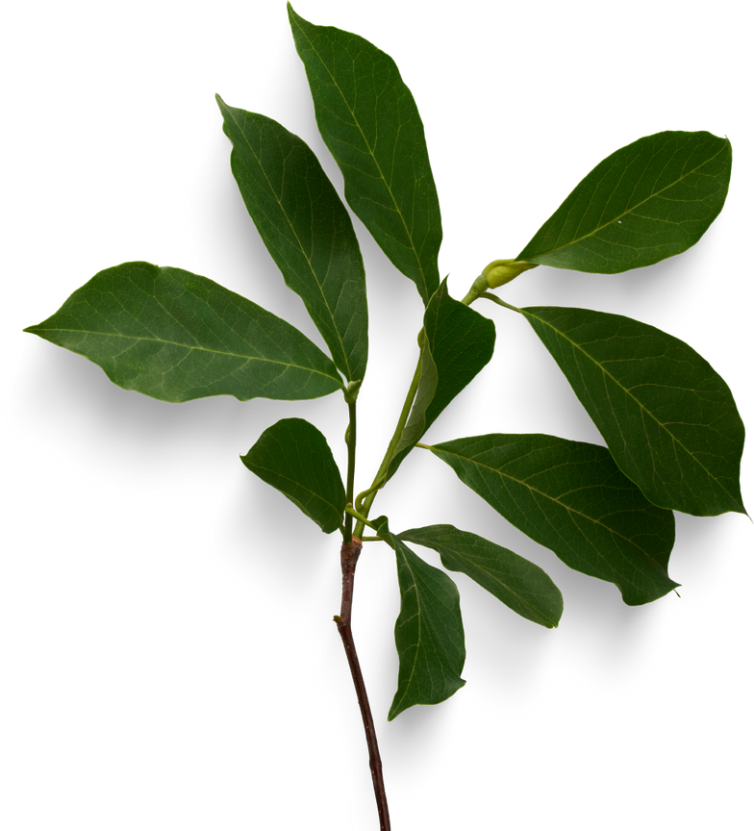
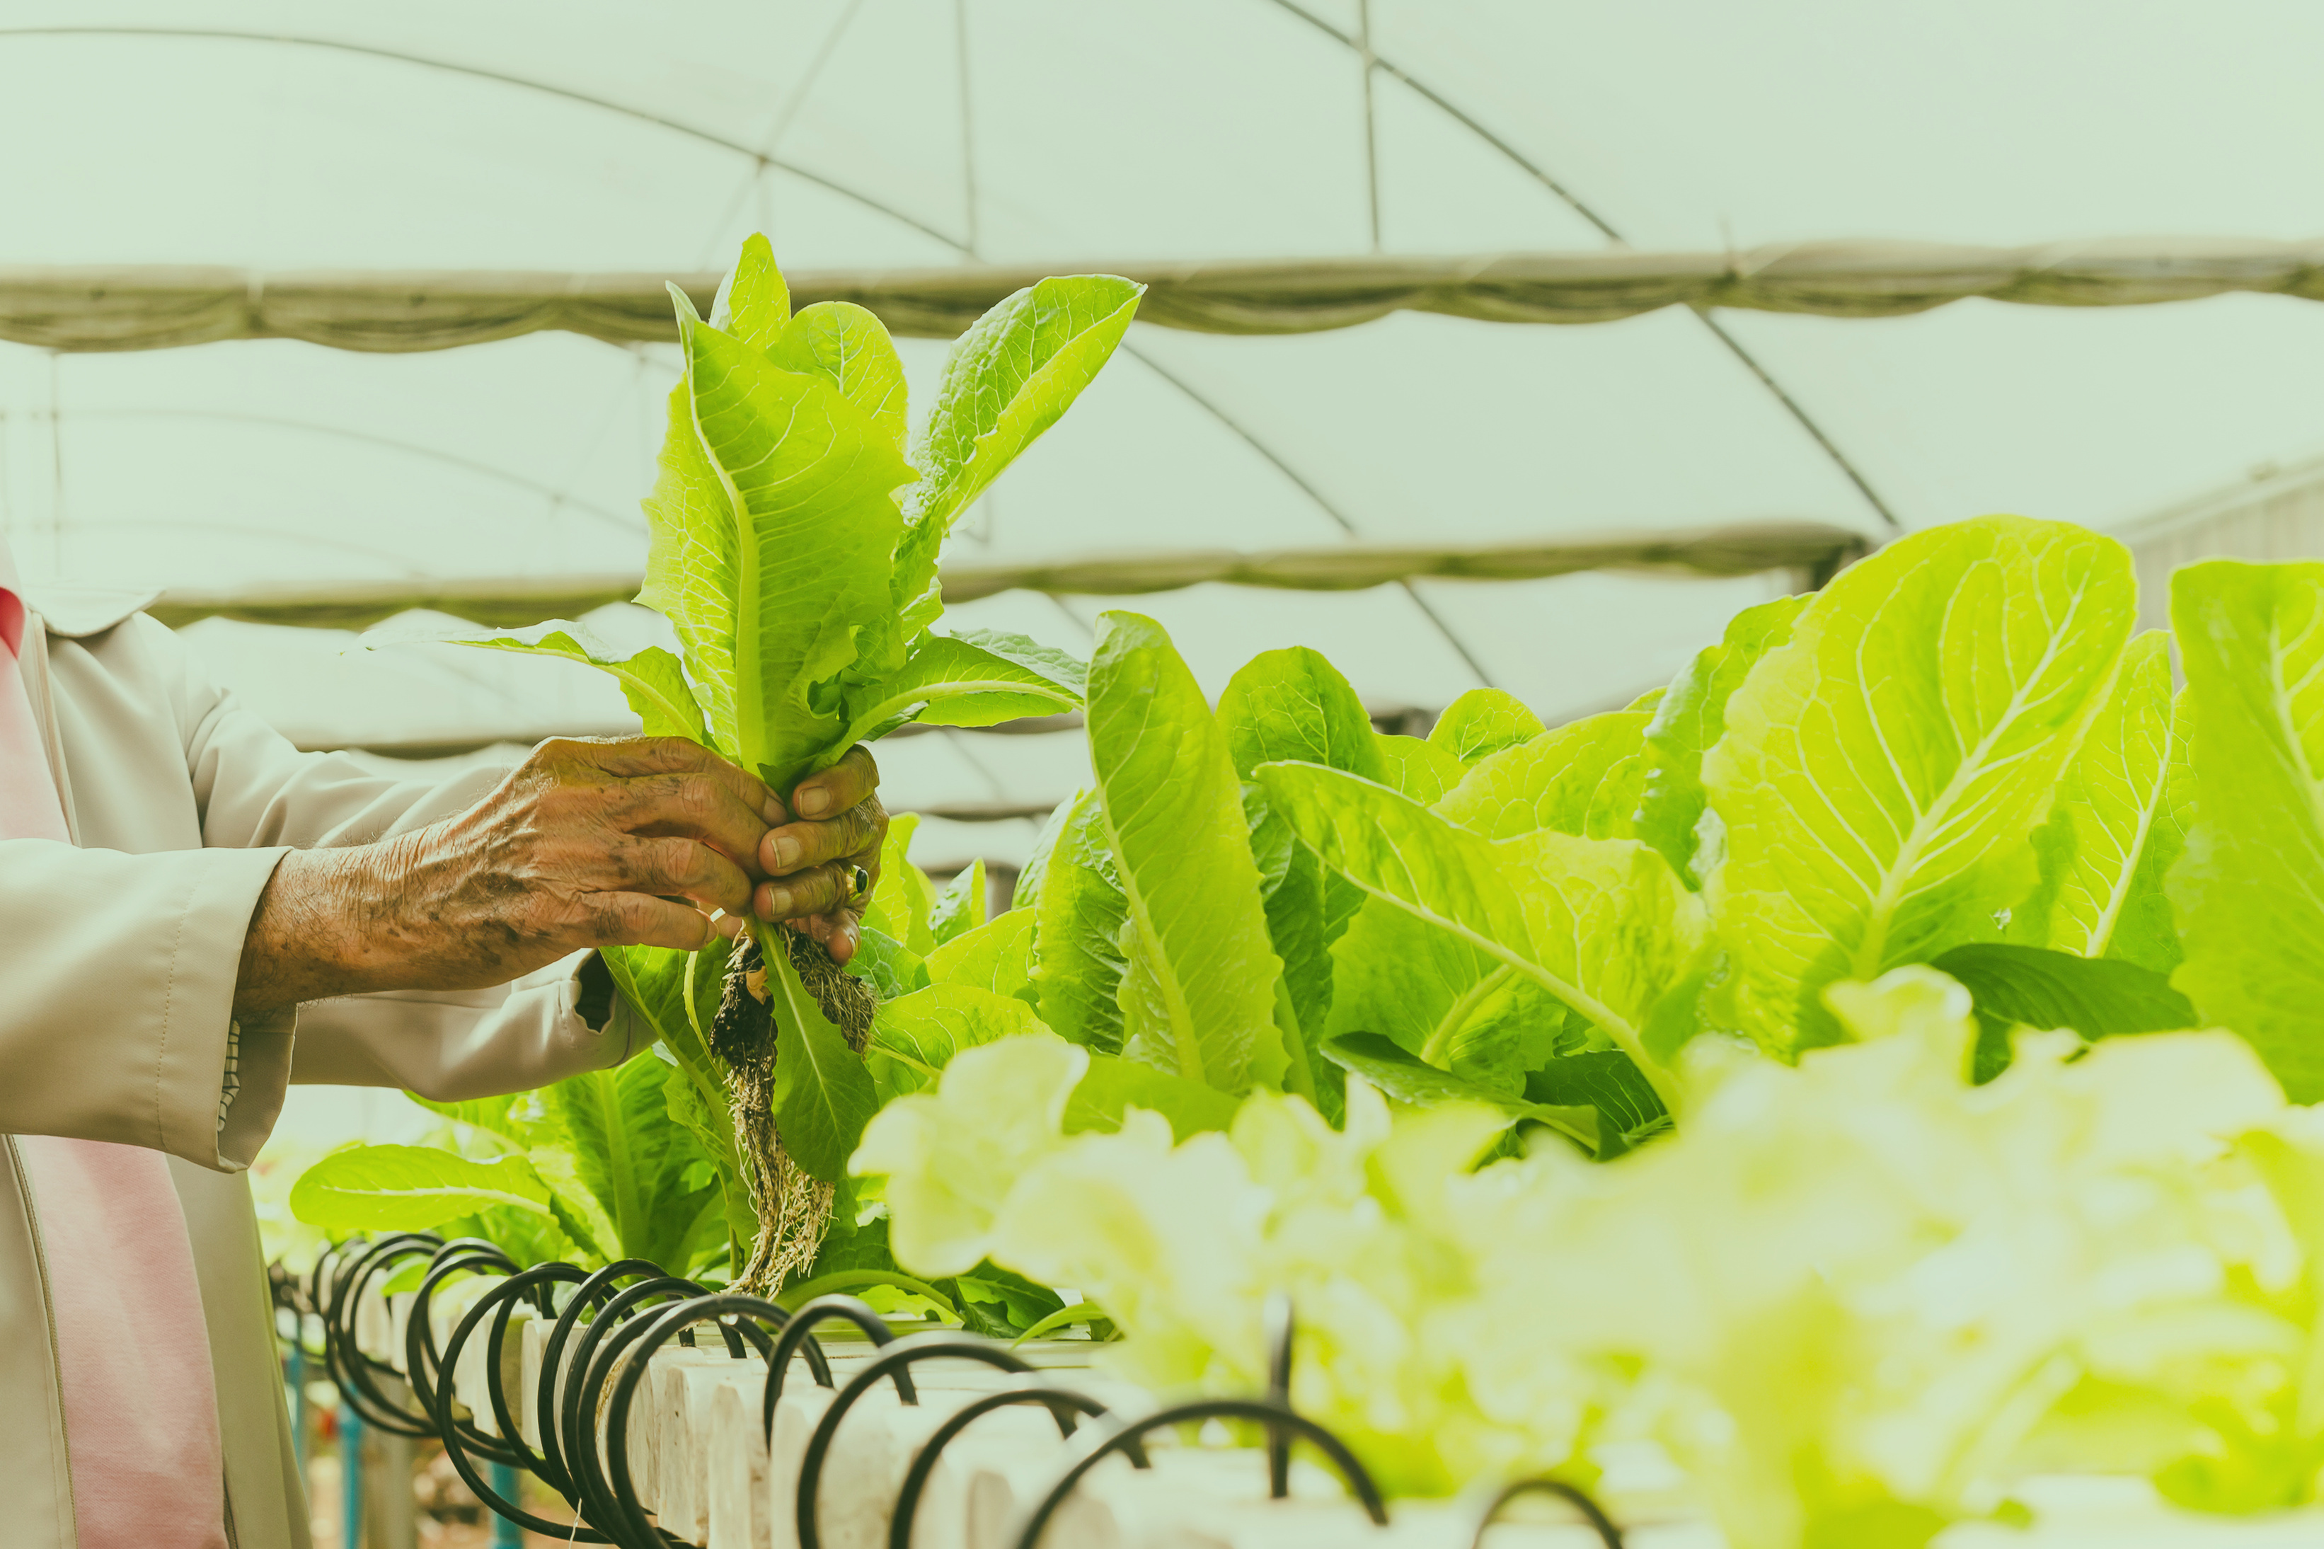

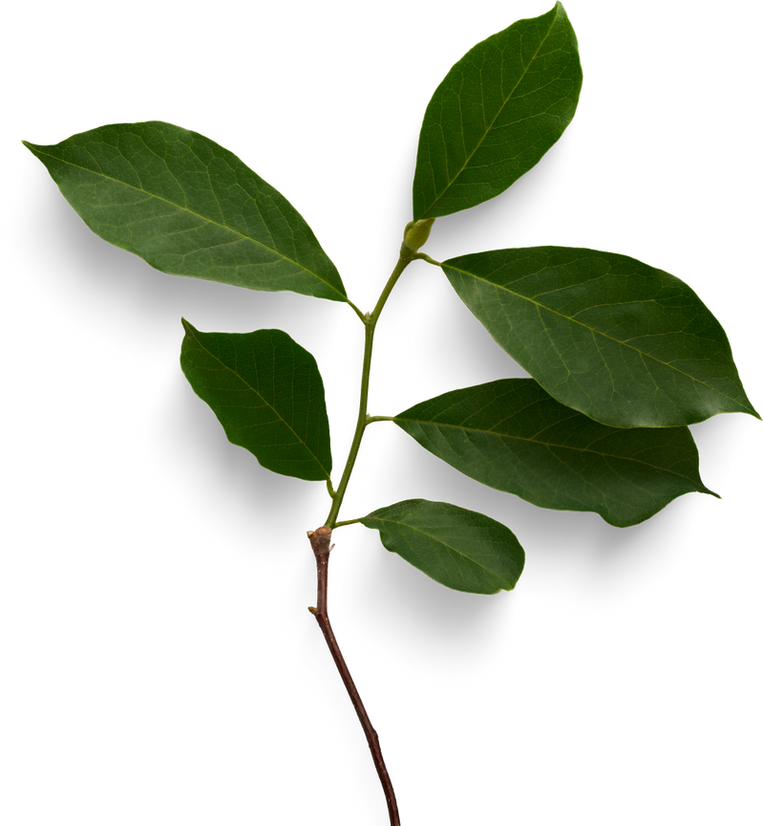
Cloud-Based Smart Agriculture System
By: CropCoders

Slide 2
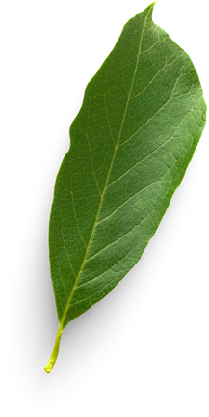
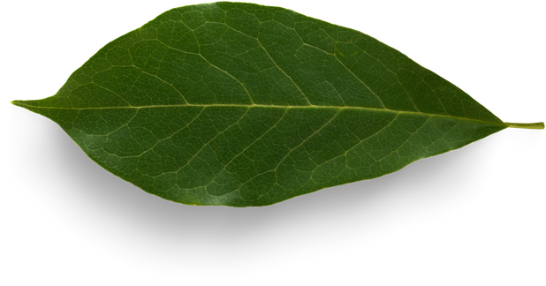
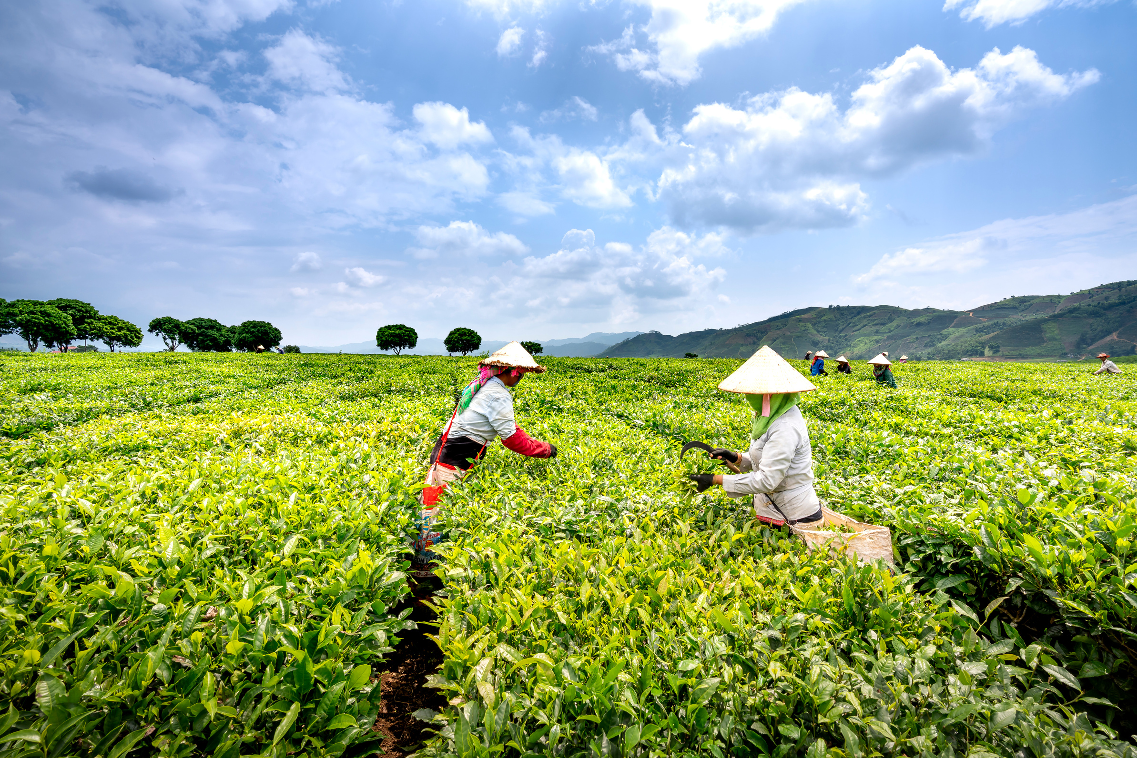
Problem Statement
Modern agriculture is increasingly challenged by unpredictable weather patterns, inefficient use of resources, and the growing demand for higher crop yields. Traditional farming methods often rely on manual monitoring and decision-making, which are time-consuming, error-prone, and lack scalability. While some farmers use standalone IoT devices for localized monitoring, these systems are often fragmented, costly, and lack integration with cloud infrastructure. The absence of real-time data collection and automated decision-making severely limits the potential for efficient resource management and sustainable farming practices. There is a critical need for a cost-effective, scalable, and integrated solution that combines sensor networks, cloud computing, and data analytics to provide real-time insights and automate agricultural processes for improved productivity and sustainability.

Slide 3

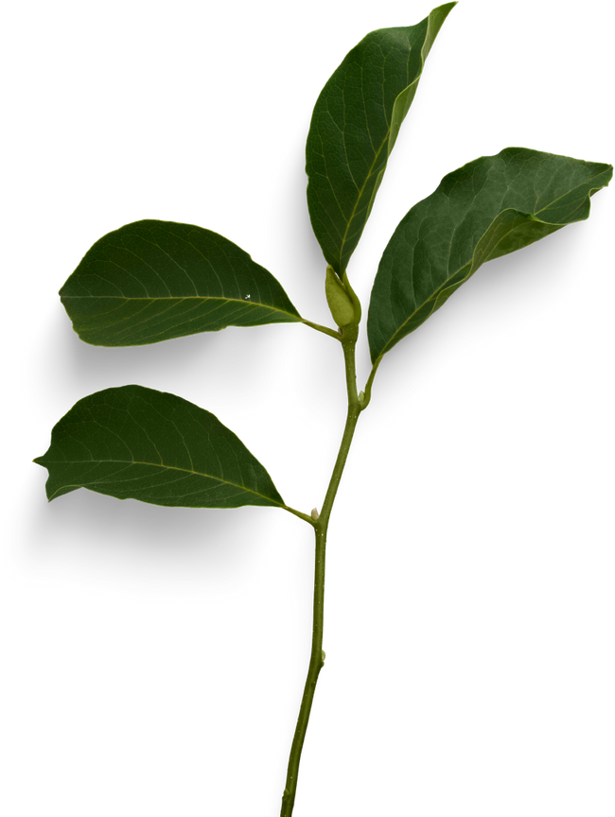
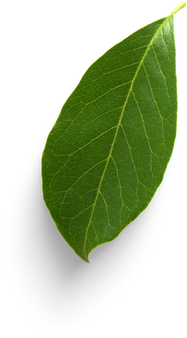
Phases of Project
PHASE 01
PHASE 02
Research and Initialization
Understand the problems faced by farmers.
Identify required sensors, tools, and technologies.
Gather real-world data needs and existing solutions.
System Design and Development
Design the architecture (IoT + Cloud).
Develop or connect sensors and microcontrollers
Set up cloud storage and data analytics platform.

Slide 4
Phases of Project
PHASE 03
PHASE 04
Testing and Implementation
Test system in real or simulated farm conditions.
Ensure proper data transmission and accuracy.
Implement automation features (like smart irrigation)
Optimization and Finalization
Collect user feedback and system performance data.
Analyze results to measure efficiency and impact.
Optimize system for scalability and better decision-making.

Slide 5
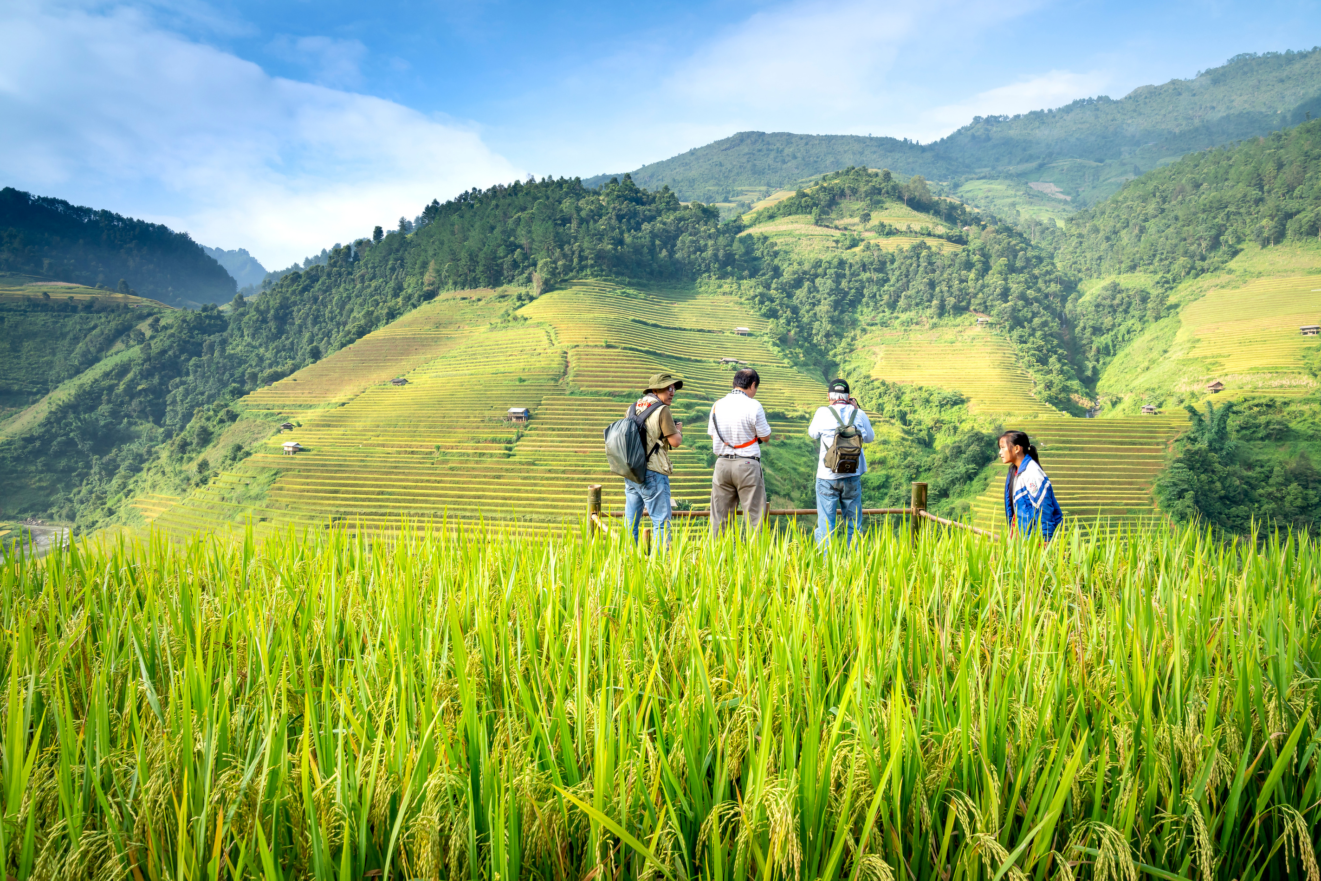
Existing Solutions
While several modern agricultural technologies exist, most are either standalone, costly, or lack full integration between sensors, cloud platforms, and automated decision-making. There is still a significant gap in affordable, scalable, and easy-to-use cloud-based smart agriculture systems—especially for small to medium-sized farms.

Slide 6
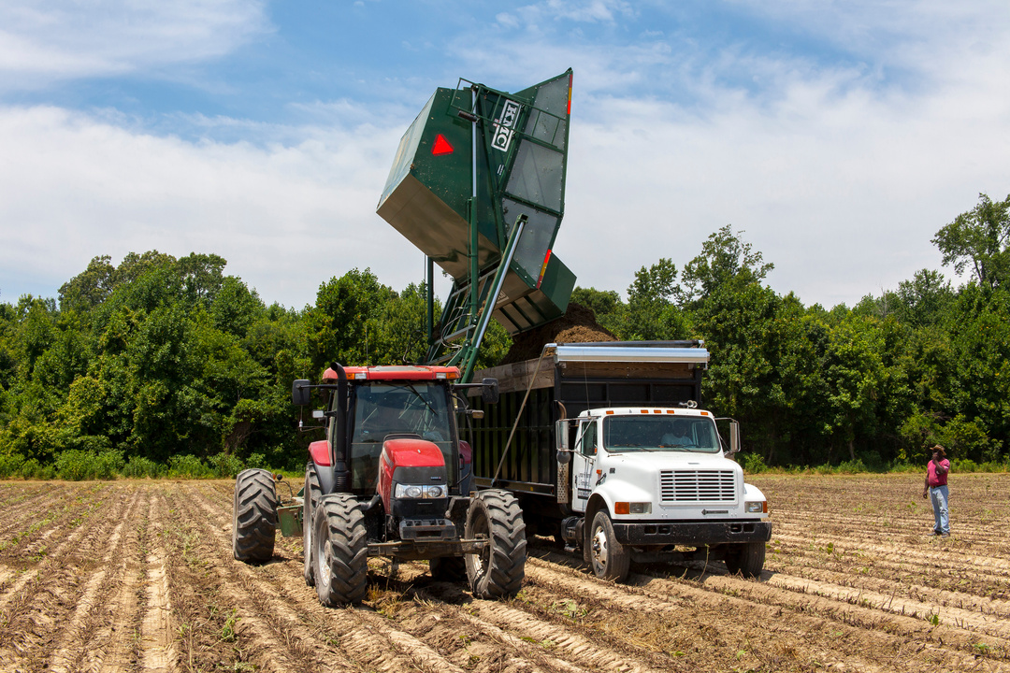
Standalone IoT-Based Monitoring Devices
Devices Devices like soil moisture sensors, weather stations, and temperature/humidity monitors are used by farmers to collect environmental data.
Limitations: These systems often work in isolation, lack cloud connectivity, and require manual intervention for data analysis and decision-making.
Precision Agriculture Systems
Advanced solutions like John Deere’s precision farming equipment or Trimble’s Ag Software help optimize planting, irrigation, and fertilization.
Limitations: These solutions are effective but often expensive and complex, making them inaccessible to small- and medium-scale farmers.

Slide 7
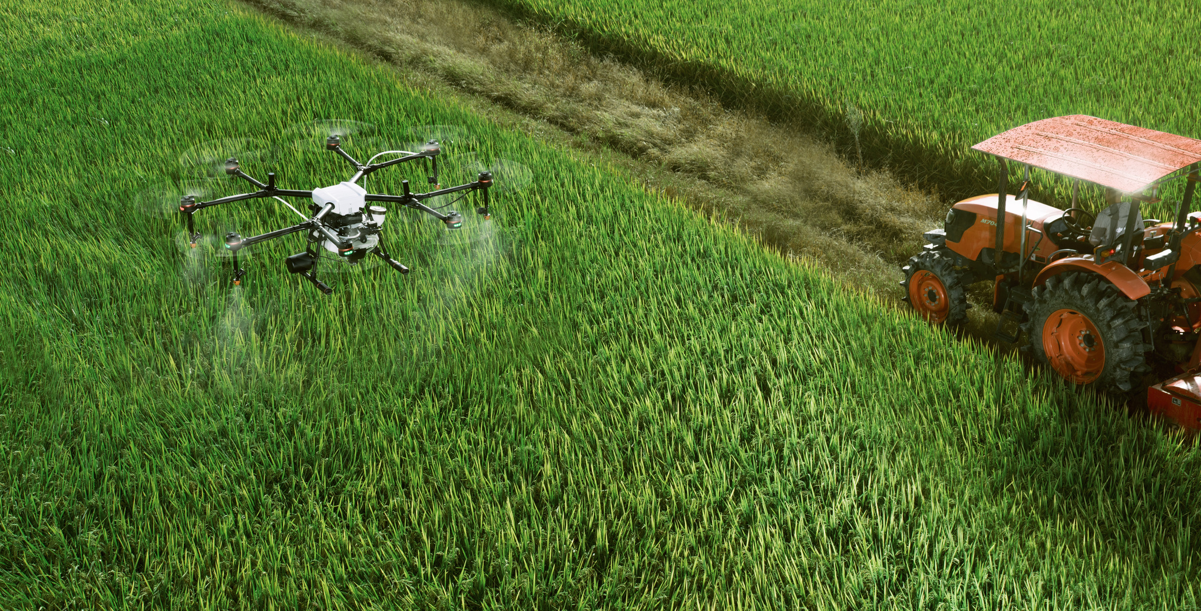
Cloud-Based Platforms (Emerging)
Platforms such as Microsoft Azure FarmBeats and IBM Watson Decision Platform for Agriculture offer cloud-based data analytics for farms.
Limitations: These platforms are still gaining adoption, and often require sophisticated infrastructure and technical knowledge to implement effectively.
Drones and Satellite Imaging
Used for aerial imaging, crop health monitoring, and mapping of farmland to support data-driven decisions.
Limitations: These solutions are useful for large-scale operations but may not provide real-time ground-level data and require expertise for analysis.

Slide 8
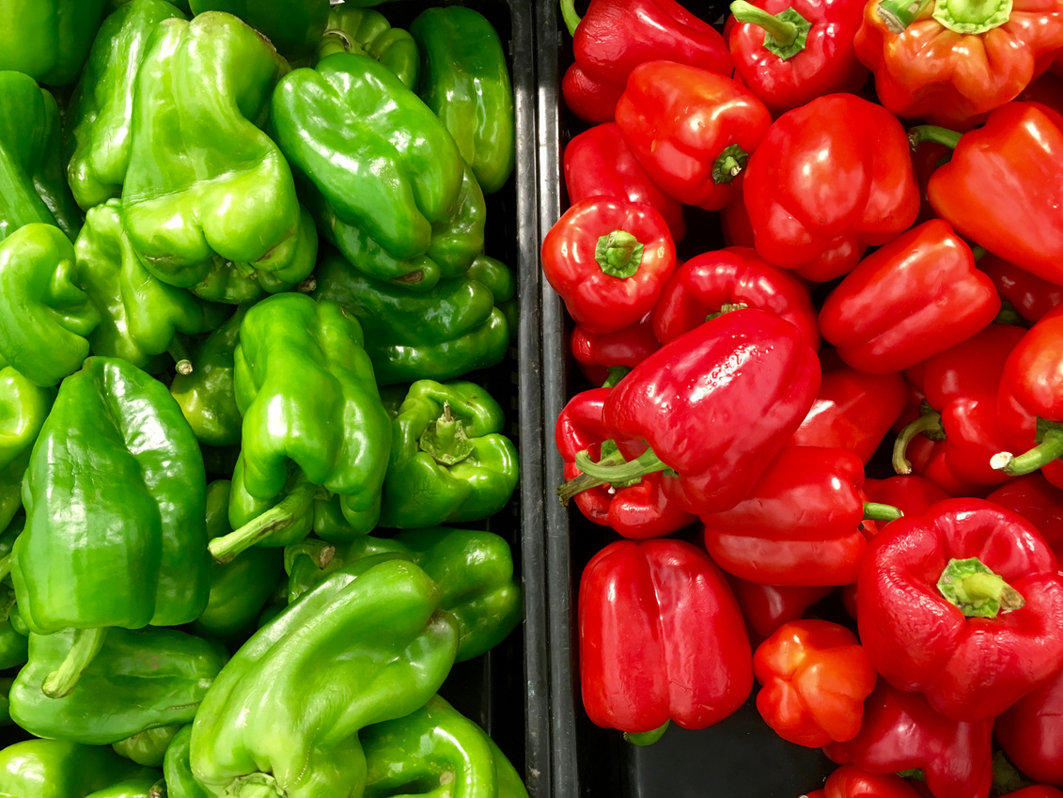
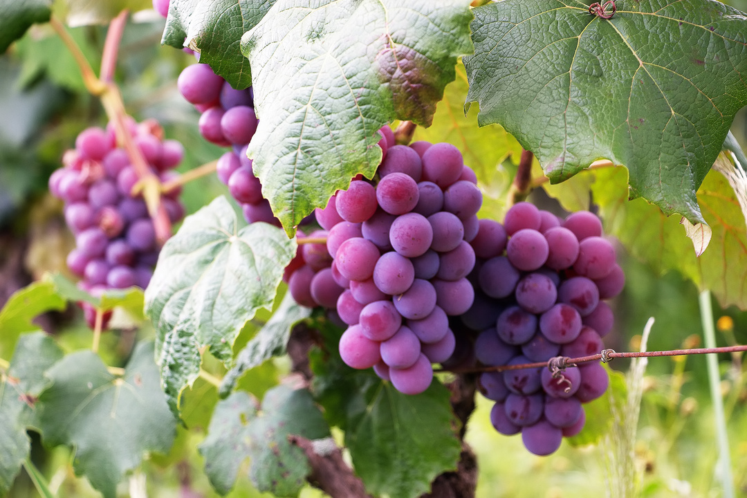
Traditional vs Smart Agriculture
Traditional Agriculture
•Manual monitoring of soil, weather, and crop health.
•Delayed decision-making due to lack of real-time data.
•High dependency on human labor and local knowledge.
•Limited scalability and resource optimization
•Often reactive rather than proactive.`

Slide 9
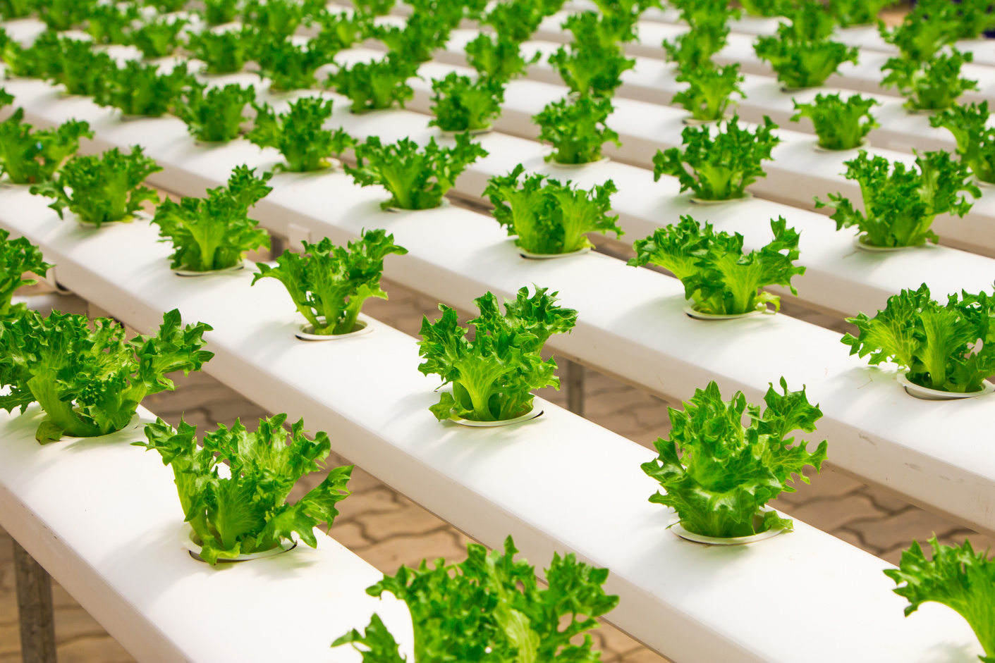
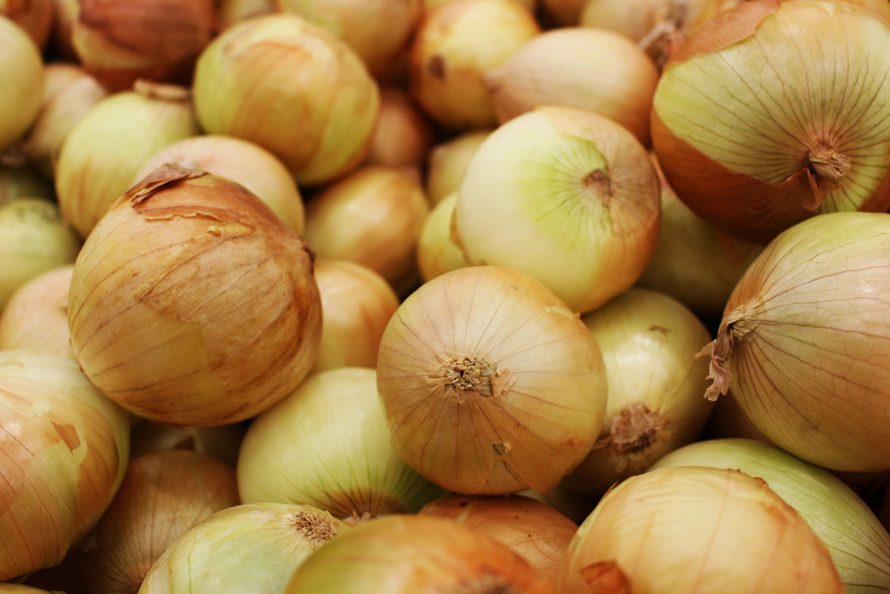
Traditional vs Smart Agriculture
Smart Agriculture (Our Contribution)
•Real-time Monitoring: Sensors collect data on soil moisture, temperature, humidity, etc., and sync it with the cloud.
•Cloud Integration: Centralized platform stores and analyzes data from multiple sources.
•Automated Decision-Making: Use of data analytics and AI for recommendations (e.g., when to irrigate or fertilize).
•User-Friendly Dashboard: Accessible insights and alerts for farmers via mobile or web apps.
•Cost-Effective & Scalable: Modular system that can be customized to farm size and needs.
•Sustainable Farming: Efficient use of water, fertilizers, and other inputs reduces waste and environmental impact.

Slide 10
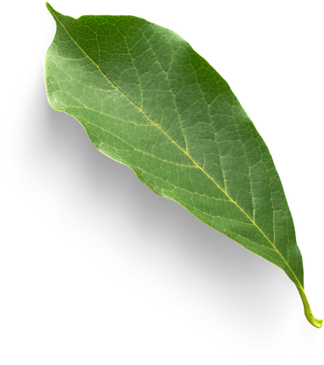
SWOT ANALYSIS
Strengths
•Real-time data and cloud analytics improve decision-making.
•Scalable and modular design fits various farm sizes.
•Reduces manual labor and human error.
•Promotes sustainable farming with efficient resource usage.
•Accessible interface for users with limited technical knowledge.
Weaknesses
•Initial setup may require training and infrastructure (power, internet).
•Dependence on network connectivity for cloud features.
•May need ongoing maintenance of sensors and hardware.
Opportunities
•Growing demand for sustainable and efficient farming practices.
•Expansion potential in developing countries with small-scale farmers.
•Integration with emerging tech (AI, blockchain for supply chain).
•Partnership opportunities with agri-tech and cloud service providers.
Threats
•Competition from established agri-tech giants.
•Reluctance from traditional farmers to adopt new tech.
•Data privacy and security concerns.
•Weather-related hardware failures or disruptions.

Slide 11




Work distribution and status
Akmal Ahmad Khan
Naman Gupta
Mahi Kathayat
Akarshan Kumar
Research and Supervising the team. Also helping in Backend
Handles the main Backend and Server-side Developer
Leading the Frontend and helping with Cloud Database
Leading the main Cloud computing and operations and helping with Frontend

Slide 12
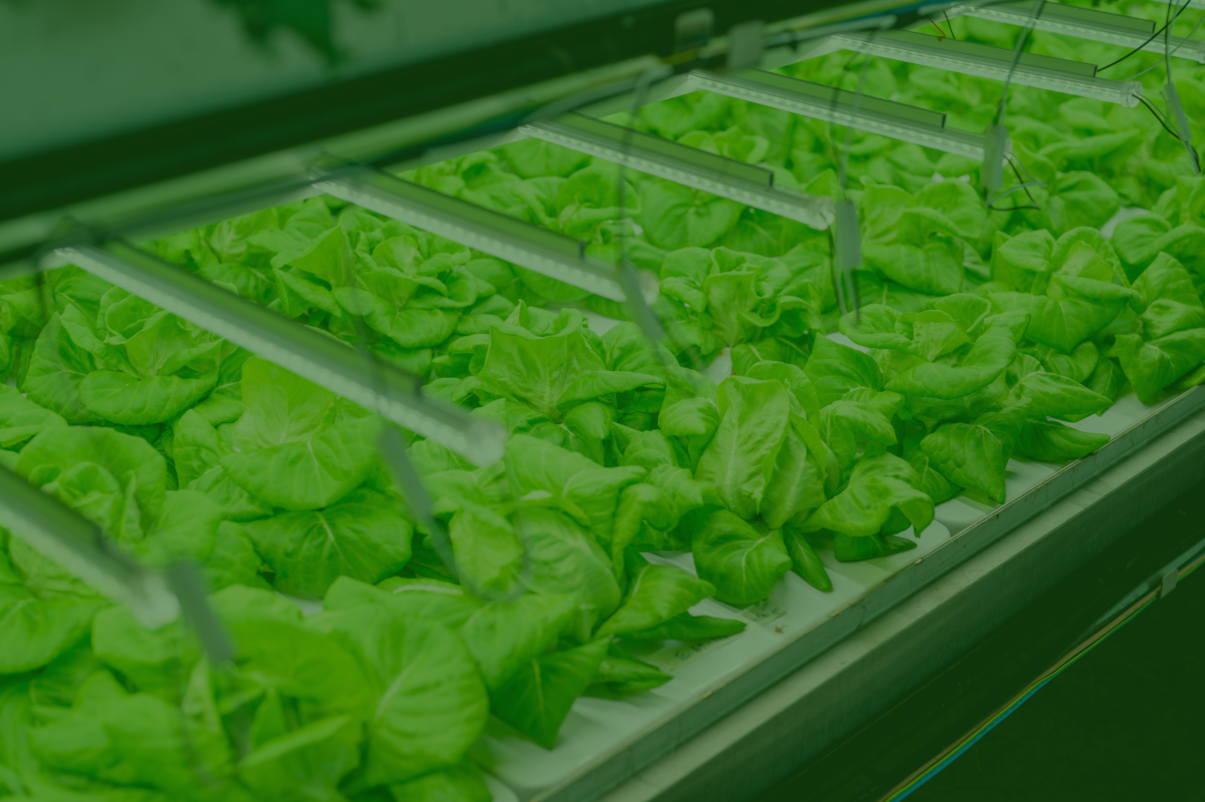
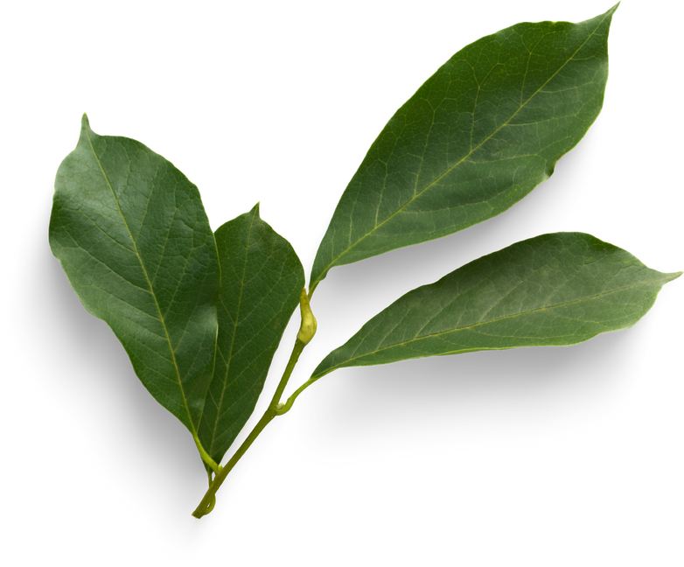
THANK YOU

